Slide 1

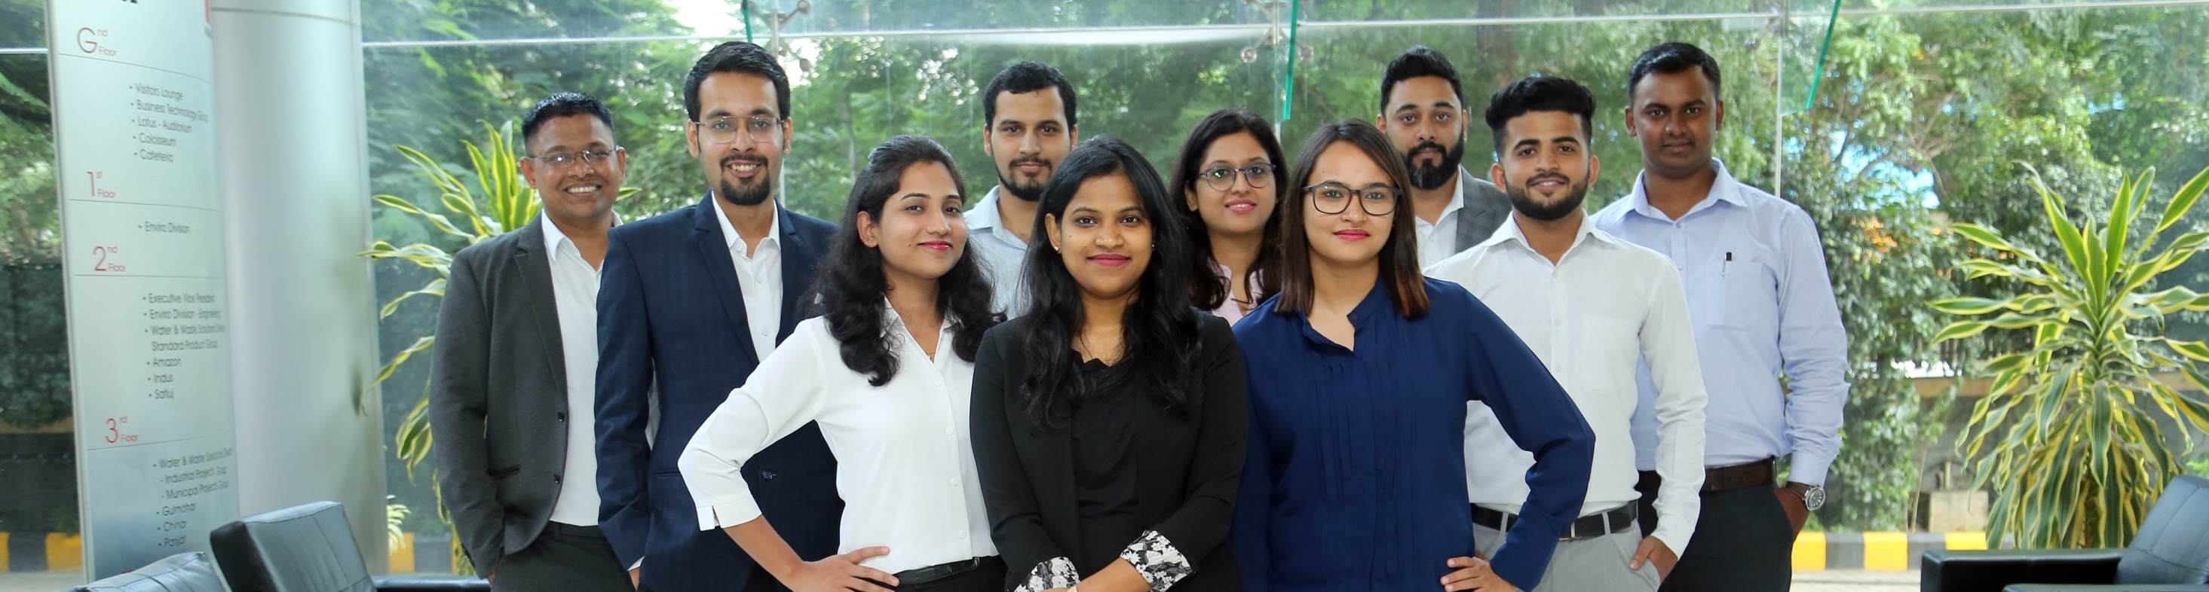
Thermax Campus 23-24

Slide 2




What does it mean to You?
Exposure to wide range of industrial processes & applications
Be at the fore front of cutting edge solution in Energy & Environment
Develop Expertise across all business functions
Be a part of ever evolving progressive Organization

Slide 3
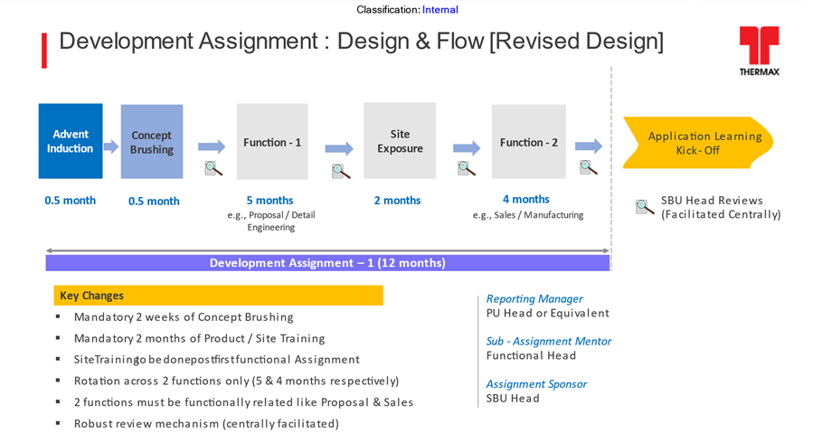
Career Progression Plan

Slide 4

Thank you

